Slide 1

The Machine Learning Process
using a decision tree model
Part 03
Reza Dibaj

Slide 2
The Importance of the Features
In Classifiers
Once a wise said:
“Classifiers are only as good as the features you provide.”
Notes:
Coming up with good features is one of the most important jobs in machine learning. The question is what makes a good feature, and how can you tell?

Slide 3
Contents
Binary Classification

Slide 4
Binary Classification
Training Data
Weight | Texture | Label
150g | Bumpy | Orange
170g | Bumpy | Orange
140g | Smooth | Apple
130g | Smooth | Apple
… | … | …
Notes:
For Binary Classification a good feature makes it easy to decide between two different classes.

Slide 5
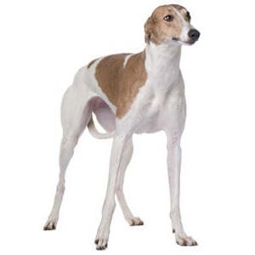
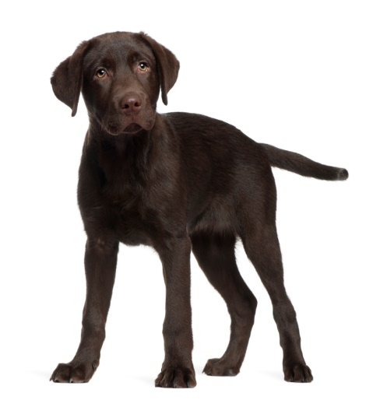
Binary Classification
One Example:
Writing a classifier to distinguish between two types of dogs:
Greyhound
Labrador

Slide 6
Binary Classification
Features for Classification:
Height in inches
Eye color
Greyhound
Labrador

Slide 7
Binary Classification
Features for Classification:
Height in inches
28”
24”
Greyhound
Labrador

Slide 8
Binary Classification
Features for Classification:
Eye color
Blue eyes
Brown eyes
Greyhound
Labrador

Slide 9
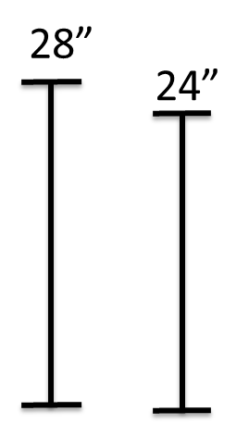
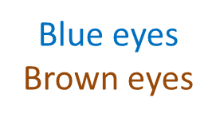
Binary Classification
Features for Classification:
Let’s make a couple of assumption:
Greyhounds are usually taller than Labradors
The eye color does not depend on the bread of the dog
Height | Eye Color
Greyhound
Labrador
Notes:
This means that one of these features is useful and the other tells us nothing. To understand why, let’s visualize them using a toy dataset that we are going to create.

Slide 10
Binary Classification
How useful the height feature is?
Greyhounds tend to be a couple of inches taller than Labradors, on average
Greyhound
Labrador

Slide 11
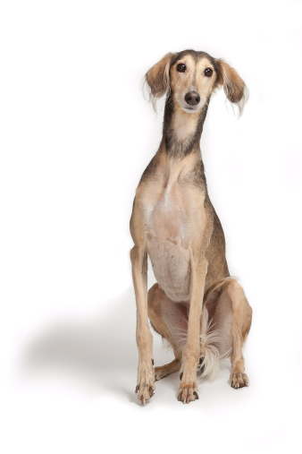
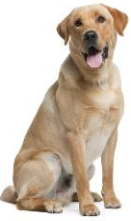
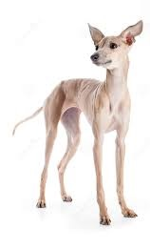
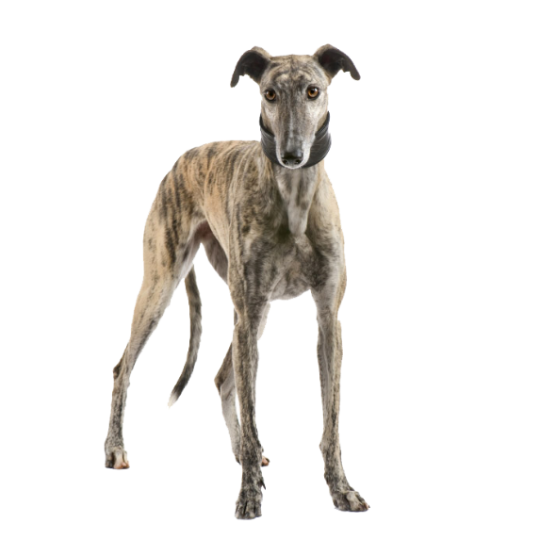
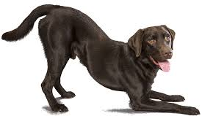

Binary Classification
How useful the height feature is?
Variation in the world
Notes:
When we think of a feature, we have to consider how it looks for different values in a population.

Slide 12
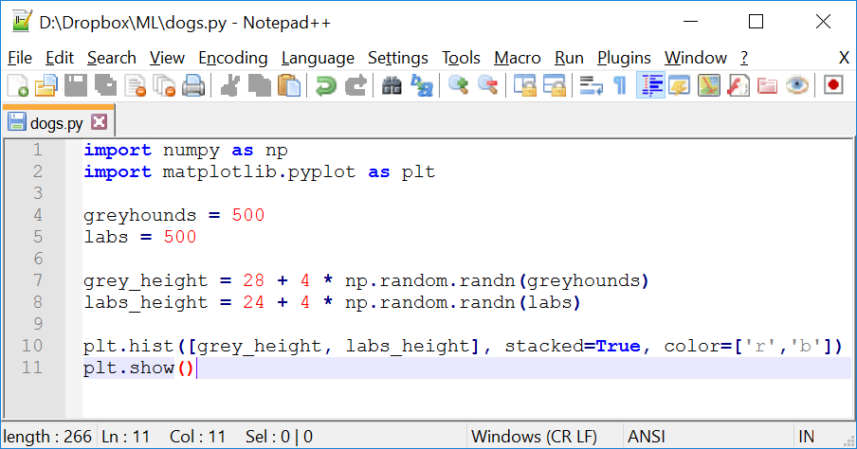
Binary Classification
Let’s head into Python for a programmatic example:
Creating population of 1000 dogs (50-50 Greyhound-Labrador)
Giving a height to each of them
Notes:
import numpy as np
import matplotlib.pyplot as plt
greyhounds = 500
labs = 500
grey_height = 28 + 4 * np.random.randn(greyhounds)
labs_height = 24 + 4 * np.random.randn(labs)
plt.hist([grey_height, labs_height], stacked=True, color=['r','b'])
plt.show()

Slide 13
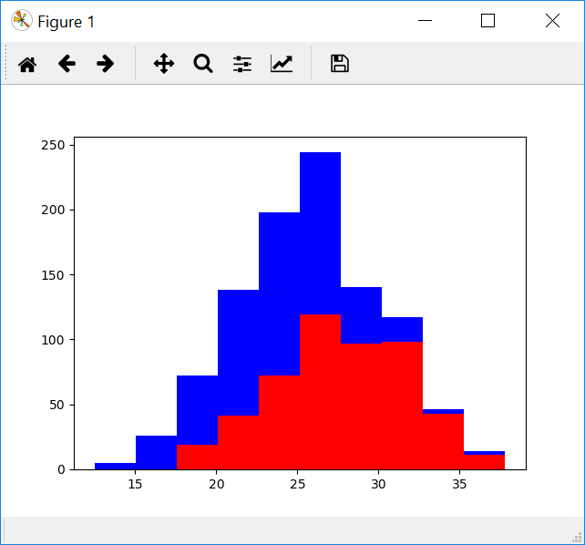
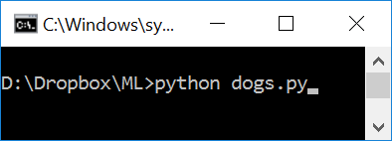
Binary Classification
Running the python code:
Notes:
python dogs.py

Slide 14
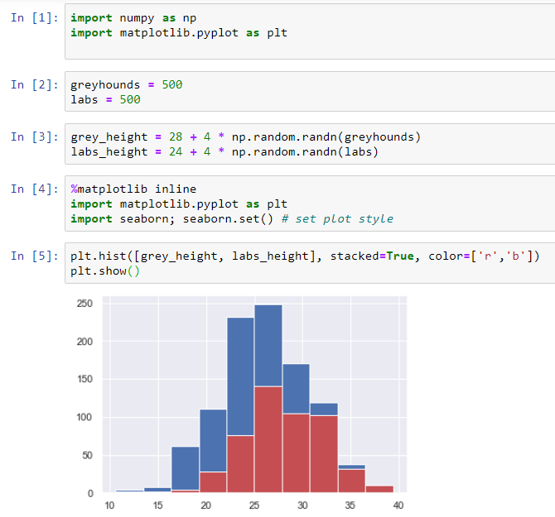
Binary Classification
Running the python code in jupyter notebook:

Slide 15
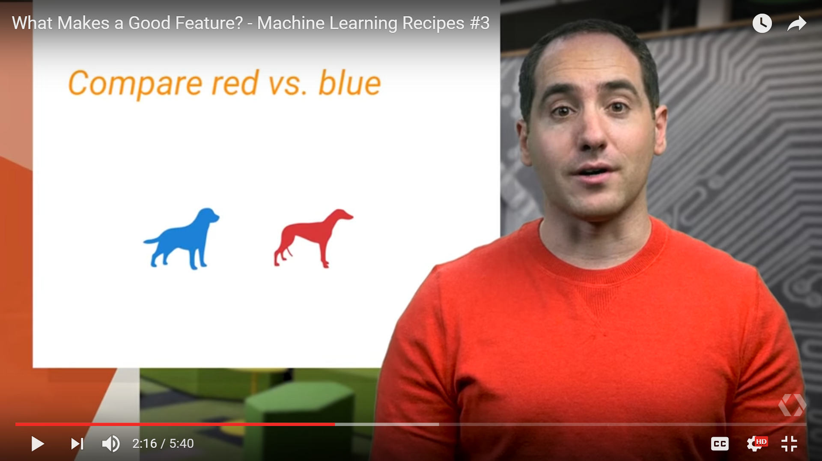
Binary Classification
Let’s simplify it and look at it piece by piece:
Lab? or Grey?
About 80% of dogs at this height are Labradors.
About 95% of dogs at this height are Greyhounds.
Notes:
The probability of each type of dog is close in the middle of the chart, so height is a useful feature, but it is not perfect. That is why in machine learning we almost always need multiple features; otherwise we could just write an if-statement instead of bothering with classifier.

Slide 16
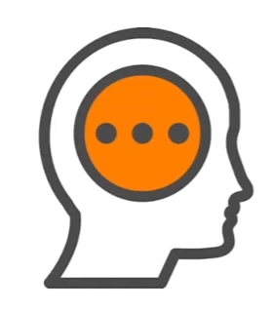
Binary Classification
Features capture different types of information
Thought experiment
Notes:
To figure out what types of features you should use, do a thought experiment.
Pretend you are the classifier. If you were trying to figure out if this dog is a Labrador or Greyhound, what other things would you want to know?

Slide 17
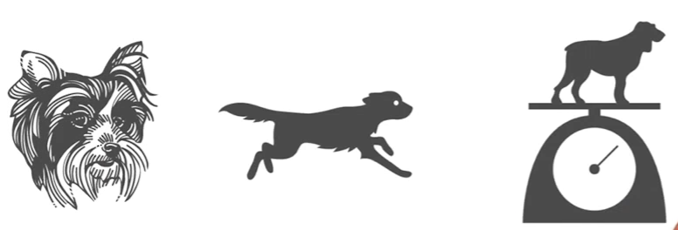
Binary Classification
What other feature should we know?
How many features should we know?
e.g. their hair length? How fast they can run? Or how much they weigh?
Notes:
How many features we should use is more of an art than a science.
As a rule of thumb, think about how many you would need to solve the problem.

Slide 18
Binary Classification
Eye color: Brown vs Blue
Let’s have the following assumptions:
Labrador
Greyhound
Notes:
For this toy example, let’s imagine dogs have only two eye colors, blue and brown. And let’s assume the color of their eyes does not depend on the breed of dog.

Slide 19

Binary Classification
Important:
When for the most values, the distribution is about 50/50, literally the feature tells us nothing!
Important:
Avoid useless features!
Notes:
When for the most values, the distribution is about 50/50, literally the feature tells us nothing, because it does not correlate with the type of dog.
Including this useless feature like this in your training data can hurt your classifier’s accuracy. That is because there is a chance that they might appear useful purely by accident, especially if you have only a small amount of training data.

Slide 20

Binary Classification
Independent features are the best!
Notes:
Independent features give you different types of information.

Slide 21
Binary Classification
Question:
As we have height in inches, would it be helpful if we add height in centimeters?
Answer:
No, because it is perfectly correlated with one we already have.
Note:
Avoid Redundant features!
Notes:
It is good practice to remove highly correlated features from our training data.
That is because a lot of classifiers are not smart enough to realize that height in inches and in centimeters are the same thing, and they might double count how important this feature is.

Slide 22

Binary Classification
Features should be easy to understand!

Slide 23
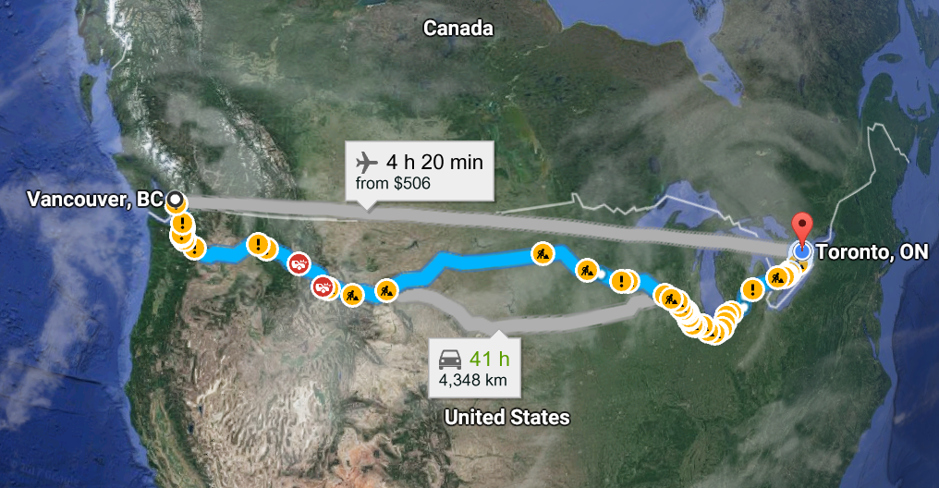
Binary Classification
Question:
Imagine you want to predict how many days it will take to mail a letter between two different cities?
Example inspired by a nice article that you can view it by clicking here.
Notes:
The farther apart the cities are, the longer it will take. A great feature to use would be the distance between the cities in miles/kilometers.

Slide 24
Binary Classification
EASY
2500 miles 3 days

Slide 25
Binary Classification
COMPLEX
Vancouver: 49° 14'N, ‎123° 7' W
3 days
Toronto: 43° 45'N, ‎79° 24' W
Notes:
A much worse pair of features to use would be the city’s locations given by their latitude and longitude.

Slide 26
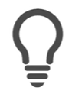

Binary Classification
Simpler relationships are easier to learn
Notes:
I can look at the distance and make a good guess of how long it will take the letter to arrive. But learning the relationship between latitude, longitude and time is much harder and would require many more examples in our training data.

Slide 27
Binary Classification
Ideal features are
Informative
Independent
Simple
Notes:
There are techniques that can be used to figure out exactly how useful the selected features are and even what combinations of them are best, so you never have to leave it to chance.

Slide 28
Next Presentation
Coming up in the next presentation
Building our intuition for supervised learning
How different types of classifiers can be used to solve the same problem
Dive a little bit deeper into how they work

Slide 29
Thank you

